Slide 1


Project Title - Glaucoma Detection using Ensemble and Transfer Learning
BHARATI VIDYAPEETH DEEMED TO BE UNIVERSITY
DEPARTMENT OF ENGINEERING AND TECHNOLOGY, NAVI MUMBAI
DEPARTMENT OF COMPUTER SCIENCE AND ENGINEERING
Project Members- Abhishek Joshi, Baasim Riyaz Kondkari, Krishna Patel, Om Patil
Guide- Prof. Vivek Solavande

Slide 2
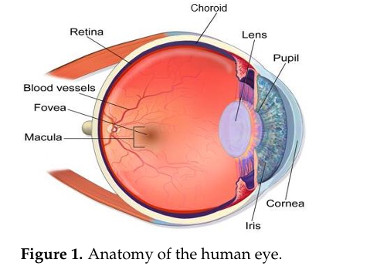
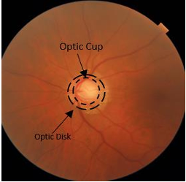
Introduction
Objective
Early detection of glaucoma to prevent irreversible vision loss.
Utilize deep learning techniques for accurate diagnosis.
Key Focus Areas
Segmentation: Precise identification of optical disc and cup.
CDR Calculation: Measure Cup-to-Disc Ratio for glaucoma detection.
Transfer Learning: Leverage pre-trained models for better feature extraction and classification.
Relevance
Enhance diagnostic accuracy and reduce manual intervention.

Slide 3
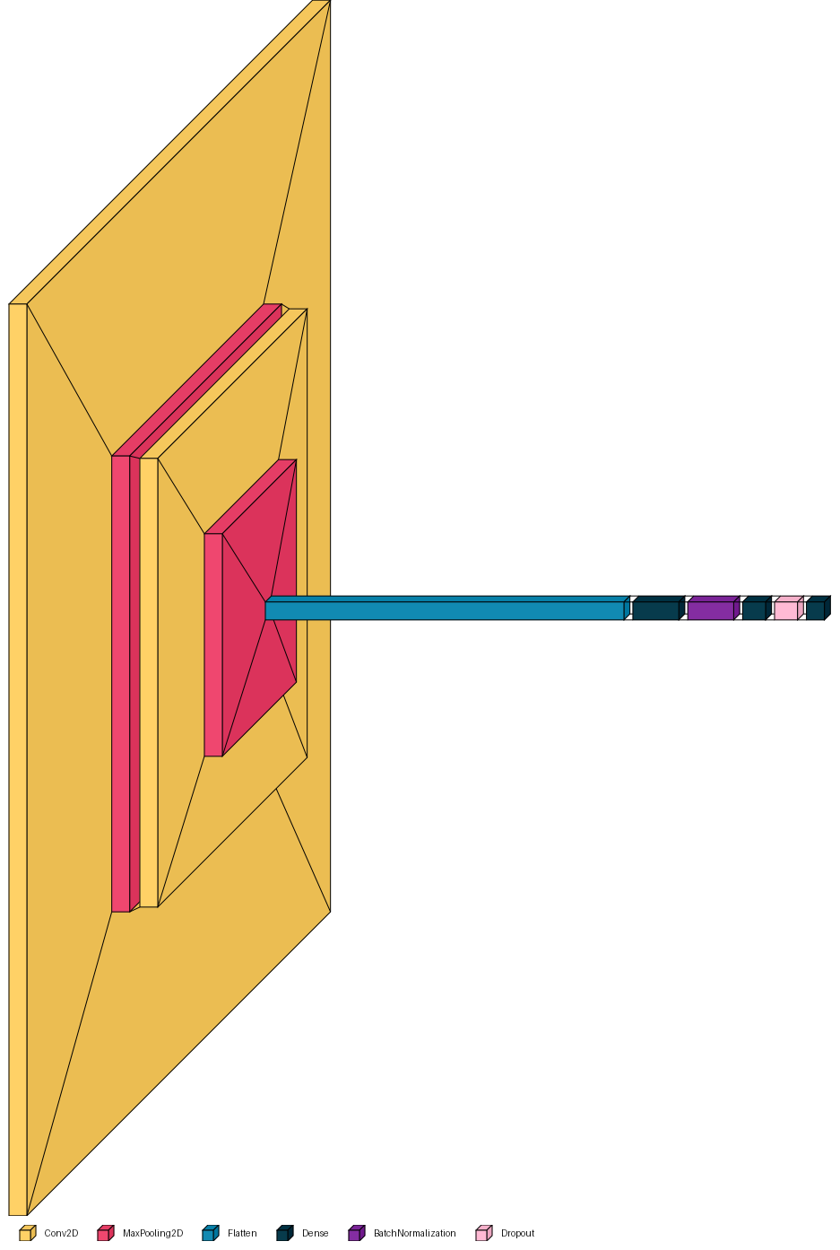
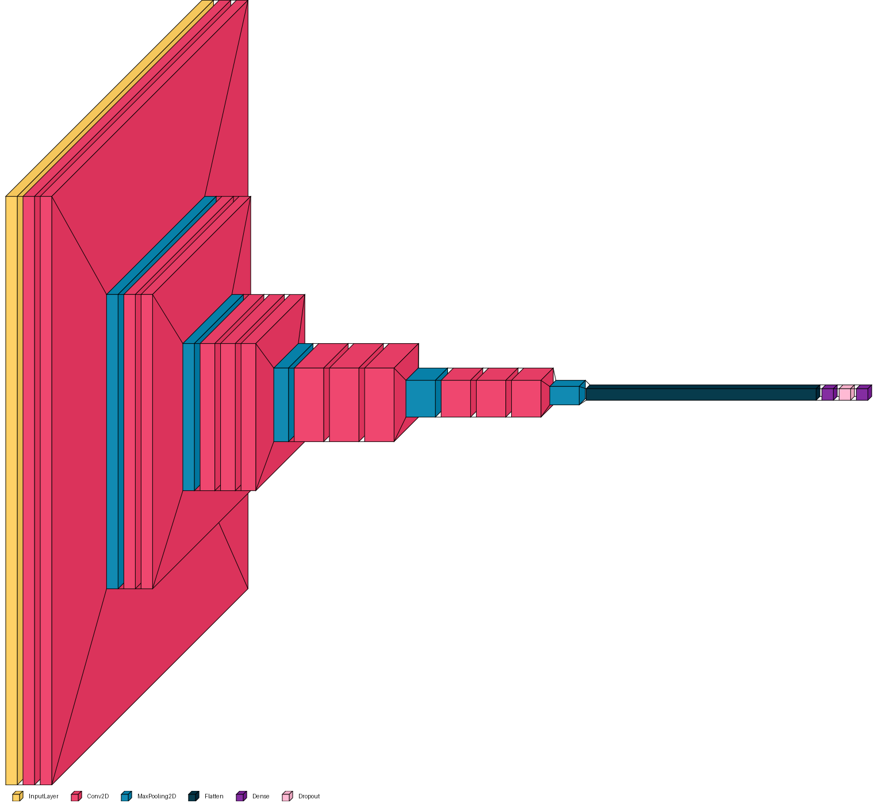
Implementation Summary
Model Training:
Trained a Vanilla CNN model for glaucoma detection.
Fine-tuned VGG16, NasNetMobile, MobileNet, InceptionNet model to leverage its advanced feature extraction capabilities.
Segmentation Model:
Developed a model to accurately segment the optical disc and optical cup.
Calculated the Cup-to-Disc Ratio (CDR) to aid in the detection of glaucoma.
Figure 1: Vanilla CNN
Figure 2: VGG16

Slide 4
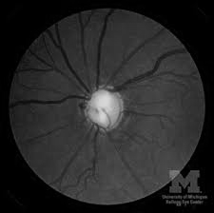
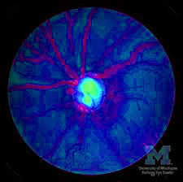
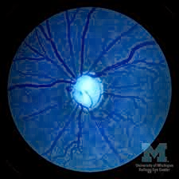
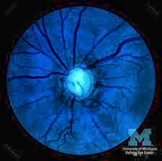
Augmentation with CLAHE
Importance of CLAHE (Contrast Limited Adaptive Histogram Equalization):
Enhanced the contrast of fundus images.
Improved visibility of optical disc and cup for segmentation.
Boosted model performance by preprocessing images with better clarity.
We noticed that augmenting fundus images with CLAHE on the variance layer enhances accuracy
Figure 1: Just B/W
Figure 2: CLAHE on H channel
Figure 3: CLAHE on S channel
Figure 4: CLAHE on V channel

Slide 5
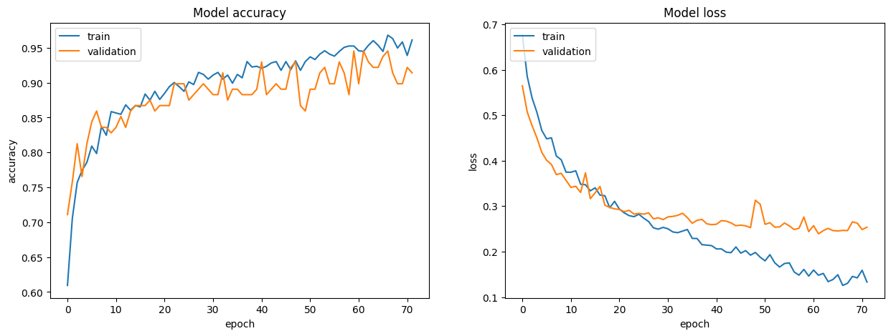
Model Accuracy without CLAHE
Model | Precision (Glaucoma) | Recall (Glaucoma) | F1-score (Glaucoma) | Precision (Normal) | Recall (Normal) | F1-score (Normal) | Accuracy
Baseline CNN | 0.8267 | 0.76 | 0.798 | 0.7769 | 0.8388 | 0.8067 | 0.7947
InceptionV3 | 0.8129 | 0.8523 | 0.8372 | 0.8389 | 0.8085 | 0.8282 | 0.8252
MobileNetV2 | 0.8148 | 0.7754 | 0.7986 | 0.7861 | 0.8236 | 0.8044 | 0.8047
NASNetMobile | 0.8038 | 0.7908 | 0.8012 | 0.7958 | 0.8085 | 0.8021 | 0.7997
VGG16 | 0.8583 | 0.7754 | 0.8148 | 0.7933 | 0.8691 | 0.8296 | 0.8286

Slide 6
Model Accuracy with CLAHE
Model | Precision (Glaucoma) | Recall (Glaucoma) | F1-score (Glaucoma) | Precision (Normal) | Recall (Normal) | F1-score (Normal) | Accuracy
Baseline CNN | 0.8667 | 0.800 | 0.832 | 0.8169 | 0.8788 | 0.8467 | 0.8397
InceptionV3 | 0.8529 | 0.8923 | 0.8722 | 0.8889 | 0.8485 | 0.8682 | 0.8702
MobileNetV2 | 0.8548 | 0.8154 | 0.8346 | 0.8261 | 0.8636 | 0.8444 | 0.8397
NASNetMobile | 0.8438 | 0.8308 | 0.8372 | 0.8358 | 0.8485 | 0.8421 | 0.8397
VGG16 | 0.8983 | 0.8154 | 0.8548 | 0.8333 | 0.9091 | 0.8696 | 0.8626
Model | Accuracy (Without CLAHE) | Accuracy (With CLAHE) | Accuracy Gain %
Baseline CNN | 0.7947 | 0.8397 | 4.5
InceptionV3 | 0.8252 | 0.8702 | 4.5
MobileNetV2 | 0.8047 | 0.8397 | 3.5
NASNetMobile | 0.7997 | 0.8397 | 4
VGG16 | 0.8286 | 0.8626 | 3.4

Slide 7
Ensemble Learning
Combing Weaker Models to make a Strong Model
Ensemble Learning Methods applied:
Soft Voting
Hard Voting
Stacking
Average Voting
Ensemble Method | Accuracy (Without CLAHE) | Accuracy (With CLAHE) | Accuracy Gain %
Soft Voting | 92.37% | 94.73% | 2.363588
Hard Voting | 90.08% | 94.12% | 4.043664
Stacking | 91.60% | 93.21% | 1.606947
Weighted Average | 90.84% | 95.48% | 4.640305

Slide 8
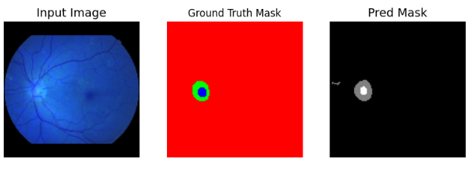
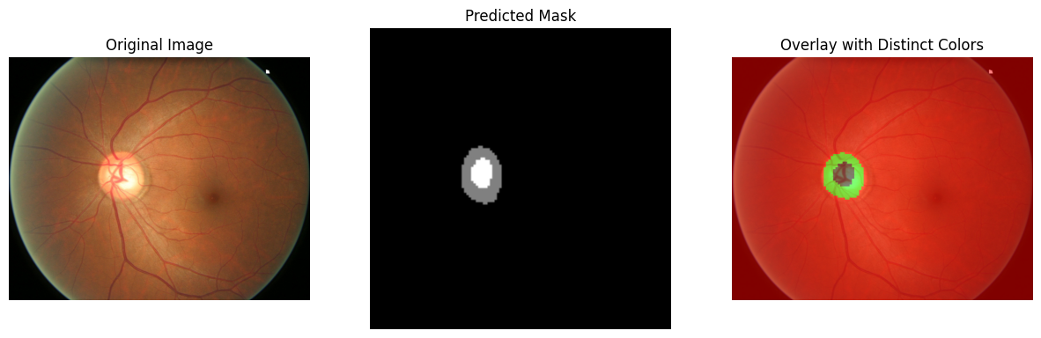

Model Output
This is the output of the segmentation model
Helps to find the optical cup and optical disc ratio
Calculate the vertical height of both he masks
Divide them to get the CDR (Cup to disc ratio)

Slide 9
Model Output
Comparison with Existing Models
Author(s) & Year | Accuracy (%) | Precision (%) | Recall (%) | F1-Score (%)
Ajitha S. et al. (2021) | 91.20 | 94.50 | 87.10 | -
Akter N. et al. (2022) | 92.80 | - | 90.00 | -
Aljohani A. & Aburasain R.Y. (2024) | 93.90 | 94.20 | 89.30 | 91.70
Shoukat A. et al. (2023) | 94.80 | - | 92.50 | -
Saha S. et al. (2023) | 94.20 | - | 93.60 | 93.80
Joshi A. et al. (2025) (Ours) | 95.48 | 96.10 | 96.20 | 96.15

Slide 10
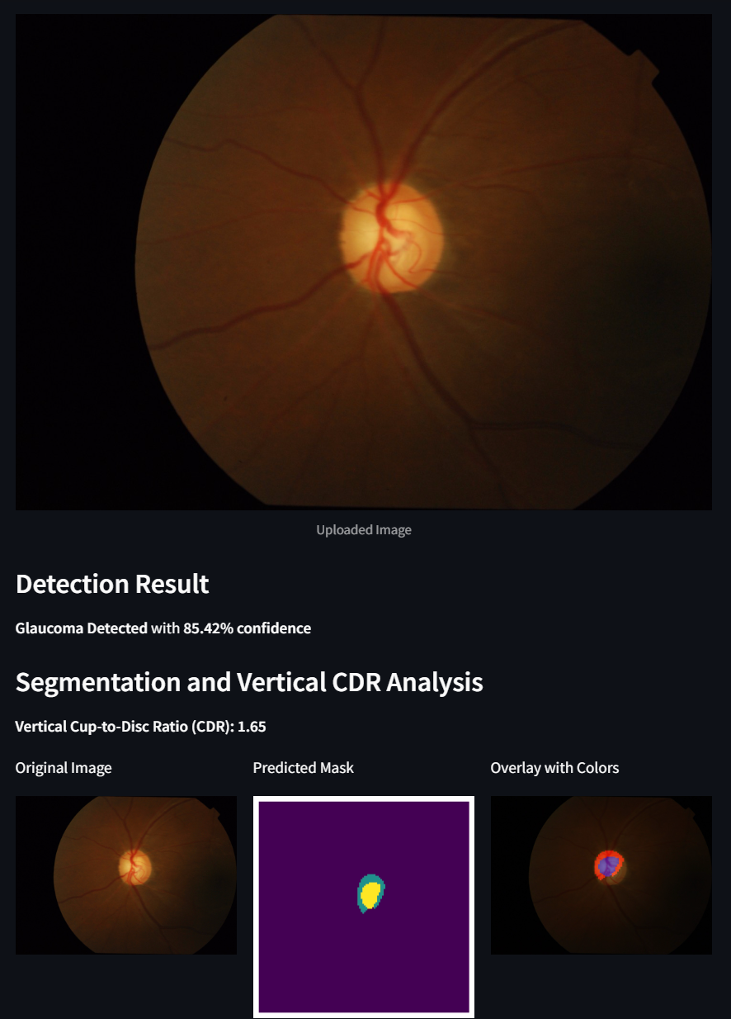
Model Output
Made a webpage to check for glaucoma
Specify if the fundus image is zoomed or not.
Wait for the model to process the image
Get accurate diagnosis of Glaucoma with near-perfect optical cup-to-disc ratio

Slide 11
Thank You

